Slide 1
AWS SES (Simple Email Service)
Email Sending Simplified with AWS

Slide 2
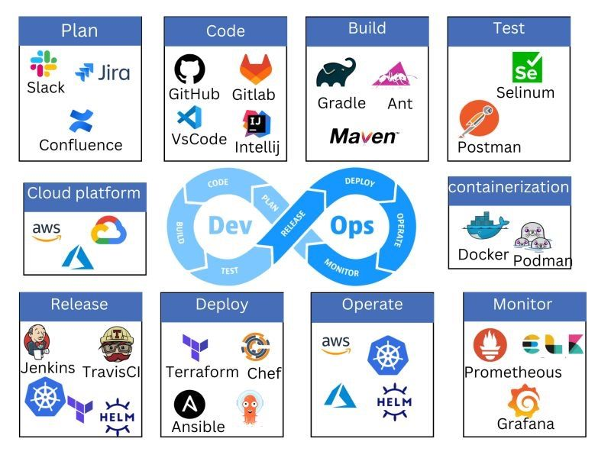

Slide 3
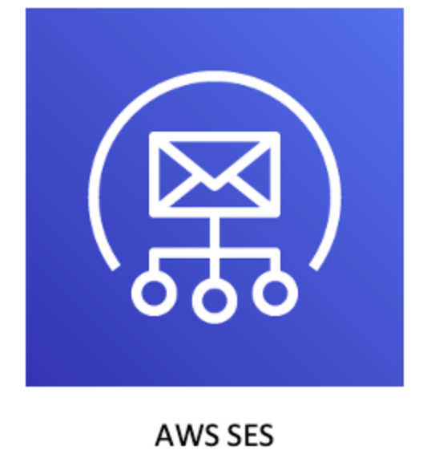
What is Amazon SES?
A cloud-based email sending service for sending transactional and marketing emails.
Features:
High deliverability
Scalable
Reliable
Use Cases:
Notifications
Marketing campaigns
Transactional emails (e.g., OTPs)

Slide 4
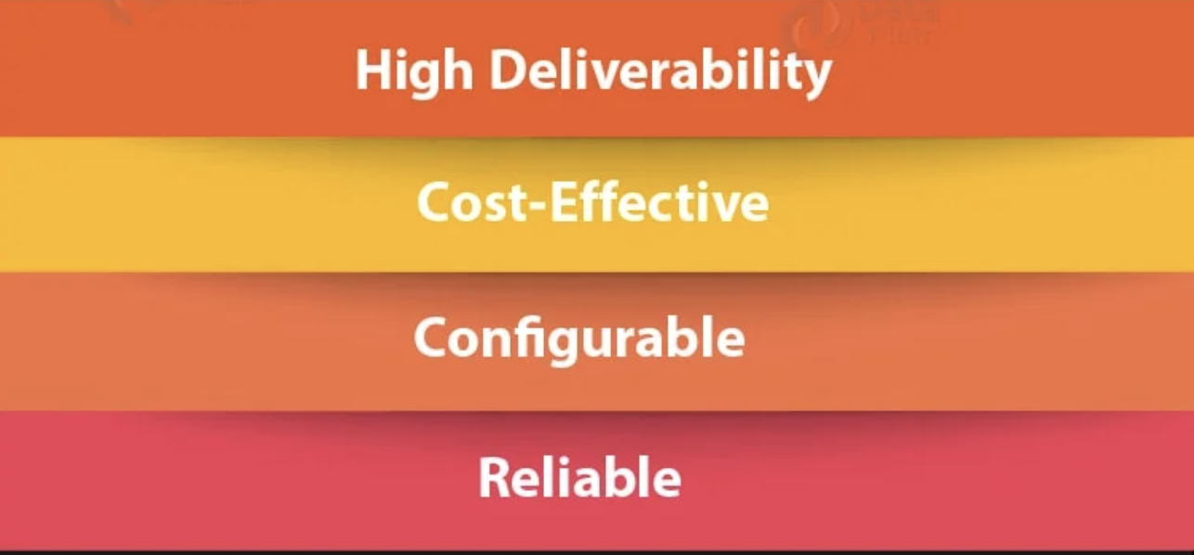
Key Features of Amazon SES
Highly scalable and cost-effective.
Support for bulk and transactional emails.
Built-in analytics (open, click-through, and bounce rates).
Integration with other AWS services like Lambda and SNS.

Slide 5
How Amazon SES Works
Basic flow: Verify domain/email → Create SMTP credentials → Send email.
Identity types: Domain vs. Email Address.
Authentication methods: SPF, DKIM, and DMARC.
DKIM ensures that an email has not been altered in transit and verifies the sender's authenticity by attaching a cryptographic signature.
SPF allows the domain owner to specify which mail servers are authorized to send emails on behalf of their domain.
DMARC (Domain-based Message Authentication, Reporting, and Conformance) is an email authentication protocol designed to protect your domain from spoofing and phishing attacks. It builds on SPF and DKIM to provide a policy framework for email authentication and reporting.

Slide 6
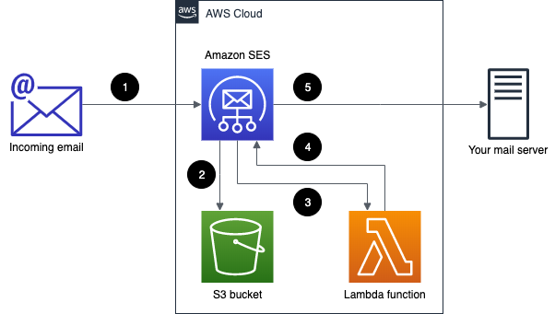
Sending Emails with AWS SES
Sending emails via SMTP Interface.
Using AWS SDKs (e.g., Boto3 for Python).
Limits and quotas.

Slide 7
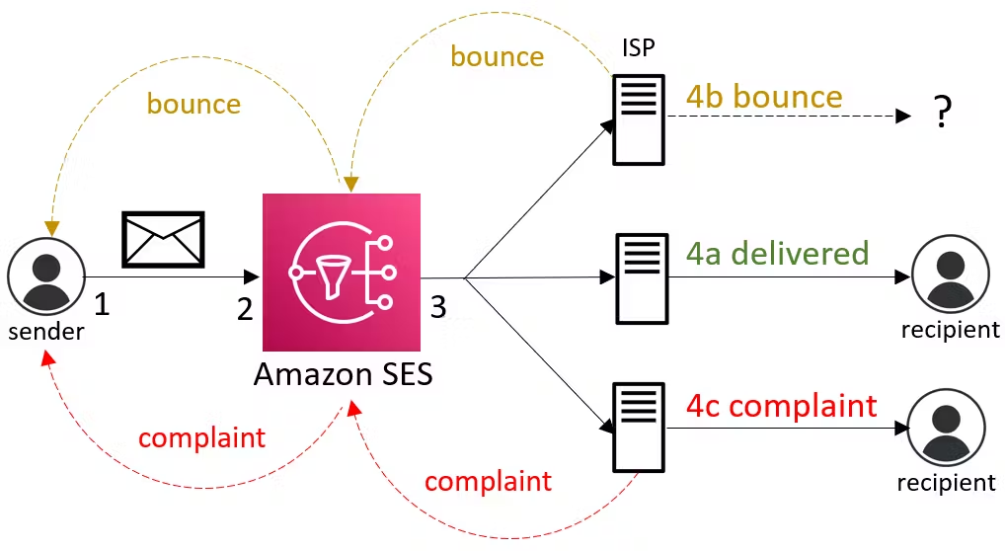

Slide 8
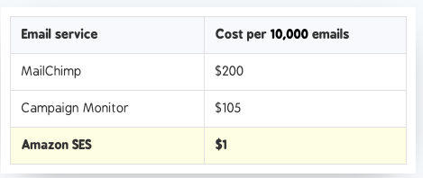
SES Pricing
Emails sent: $0.10 per 1,000 emails
Attachments: Cost for data transfer applies
Free Tier: 62,000 emails per month when sent from an EC2 instance

Slide 9

SES Best Practices
Use DKIM and SPF for email authentication.
Monitor bounce and complaint rates.
Regularly review email metrics.
Using IAM for access control.

Slide 10
Question: Sending Bulk Emails to Customers
You have an e-commerce website and need to send order confirmation emails to thousands of customers every day. You’ve decided to use AWS SES for this purpose.
What steps would you take to configure SES to handle these bulk emails effectively?
How would you ensure that your emails are successfully delivered and avoid being marked as spam?
How would you monitor and handle bounce rates or complaints using AWS SES?

Slide 11
Steps to handle these bulk emails effectively
Setup Sender Identity
Request Production Access
Use IAM for Access Control
Manage Quotas and Limits
Configure Sending
Leverage SNS for Feedback
Monitor Performance

Slide 12

Thank You

